Slide 1
AI Search Assessment
Turning insights into action to win in AI Search
Marketing Transformation / IBM Consulting / © 2025 IBM Corporation

Slide 2
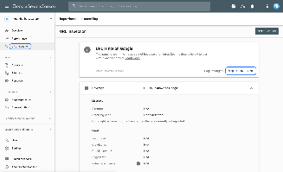
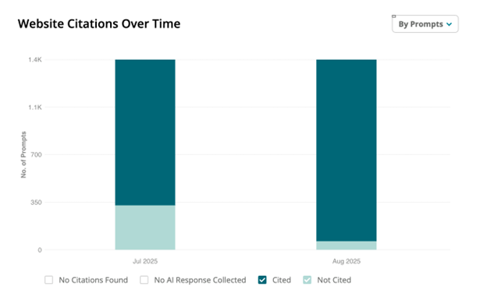
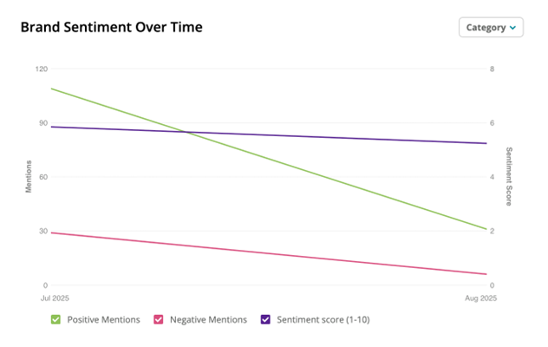
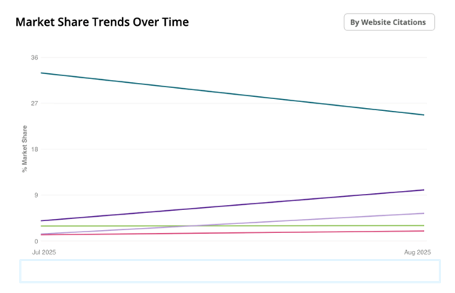
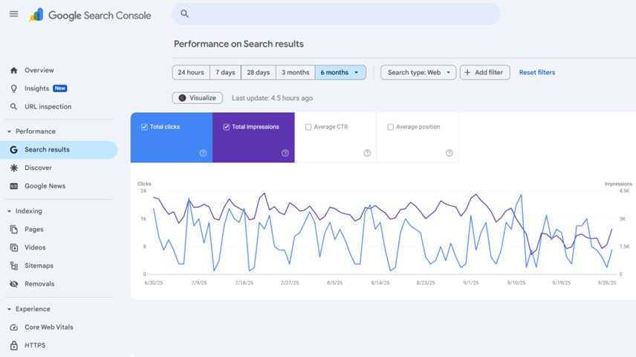
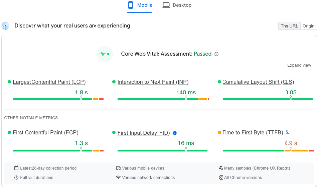
Our AI Search Assessment
Five-Pillar Analysis to Secure Your Market Position
1
Visibility in AI-Generated Answers
2
Sentiment
& Reputation Management
3
Market Position in AI Recommendations
4
SEO-Performance
& AI Integration
5
Technical AI Optimization of Digital Assets
  How often you appear
  in AI responses
  Citation rates vs. Competitors
  What's invisible to AI
  How AI systems
  describe you
  Information accuracy
  Whether strengths are cited
  Your standing in AI recommendations
  Which competitors AI prefers
  Unclaimed opportunities
  How your site supports
  AI visibility
  Structured data quality
  Content optimization
  Infrastructure
  readiness
  Markup coverage
  Site performance
  for AI
Deliverable: AI Readiness Evaluation + Action Plan
Confidential IBM Consulting 2025

Slide 3
GEO Assessment : Approach/Timeline
Total duration typically 4-5 weeks, depending on data availability/complexity.
Preparation (3-4 days)
Sharpen scope, goals, KPIs; access & artifact checklist; kick-off workshop.
Visibility in AI-answers (1,5-3 days)
Assess whether the brand appears in AI-generated responses across major GenAI platforms (Search + Assistants).
Sentiment & Reputation in AI Responses (1-2 days)
Understand tone, sentiment, trustworthiness and accuracy of AI outputs referring to the brand.
Market Position in AI Recommendations (1,5 – 3 days)
Determine how often and in what context the brand is recommended vs competitors.
SEO Performance & AI Integration (2-4 days)
Playback with agency & stakeholders; ownership, next steps, success measurement.
Technical AI Optimization of Digital Assets (2-4 days)
Review AI-readiness of content and technical infrastructure.
Confidential IBM Consulting 2025

Slide 4
Five Questions Marketers will be able to answer after our Assessment
ARE YOU VISIBLE WHEN AI ANSWERS QUESTIONS IN YOUR CATEGORY?
Test: Ask ChatGPT/Claude/Perplexity 10 customer questions
Track: How often your brand is mentioned
Benchmark: Compare to top 3 competitors
WHAT IS AI SAYING ABOUT YOU WHEN IT MENTIONS YOU?
Positive framing or negative?
Accurate information or outdated?
Positioned as leader or alternative?
CAN AI ACTUALLY ACCESS AND UNDERSTAND YOUR CONTENT?
Technical: Schema markup, structured data
Structure: Headers, FAQs, clear answers
Crawlability: JavaScript rendering issues?
HOW DO YOU MEASURE SUCCESS WITHOUT TRADITIONAL METRICS?
New KPIs: Citation rate, sentiment, share of voice
Attribution models for AI-influenced journeys
ROI for brand presence vs. direct clicks
HOW DO YOU CREATE AI-OPTIMIZED CONTENT AT SCALE?
Volume: am I creating enough content
Quality: E-E-A-T signals, expertise, structure
Visibility: Is it tagged and readable
Confidential IBM Consulting 2025

Slide 5
Audit Team / Pricing
Team
Pricing
AI Search Lead /Strategist
SEO Specialist (Technical + On-Page Hybrid)
Content Analyst / EEAT Specialist
Data Analyst / Research Specialist
Project Manager
$40-60k based on scope of work
Assumptions: timely access/exports; joint working sessions; travel at cost
Confidential IBM Consulting 2025

Slide 6
AI Search Assessment, POC and Roll
Turning insights into action to win in AI Search
Marketing Transformation / IBM Consulting / © 2025 IBM Corporation

Slide 7
Website transformation to respond to AI Search
Strengthening brand entity and harvesting insights to improve brand delivery
GEO Assessment
Pilot recommendations
Operationalize and Scale
Finalize the business case for change
Secure required licenses and resources * see next page
Implement new processes for content and code
Prioritize and phase roll-out to full brand site
Timing: Phased based on internal team capabilities and business priorities
Analyze current AI Optimization profile and competitors generally for a defined product suite.
Surface visible patterns that will impact brand presence on AI side
Owned and 3rd party sites
Types of content
High priority topics and prompts
Understand Client’s technical configuration and ease of indexing by LLMs * see technical check list
Recommend optimization strategy for improving brand visibility in AI results
Requirements:
Access: GSC, Analytics (GA4/Adobe), SEO Platform
Client resources: Content team, Digital Marketing/SEO, DevOps
Timing: 4-5 weeks
Select priority actions from the GEO Assessment recommendations to implement through a rapid POC process.
Apply required insight, and action tools to make modifications
Technical enhancements
Content additions and/ or rework (leveraging WRITER agents)
Product/service experience updates.
Track and Measure results for 4 weeks and report on outcomes to build the business case for change.
Requirements:
Access: GSC, Analytics (GA4/Adobe), Log analysis (e.g. Cloudflare)
Client resources: Content team, Digital Marketing/SEO, Engineering, UX/Design
Timing: 6-8 weeks
Technical Site Updates
One time review and rework to optimize
Establish refresh process leveraging AI automation
Implement tracking
1
AI-enabled Content Development and Deployment
Implement Agents to condition copy and tag images to optimize; apply guardrails for legal/brand standards
Implement with automation and appropriate supervision
Develop content aligned to key citation influencers
Expand testing to align to search insights
2
Insights Mining and Reporting
Harvest insights from prompts, citations and visibility tracking
Apply agents to summarize and provide reporting for stakeholders aligned to their specific domain needs ( product, PR, customer service)
Refresh prompt evaluation on a frequent basis
3
Confidential IBM Consulting 2025

Slide 8
Technical SEO: The AI-Ready Checklist
Your website's technical infrastructure is more important than ever.
01
Structured Data & Schema Markup
AI-models rely heavily on structured data to parse entities, relationships, and attributes. Without schema, your brand and content may be misinterpreted in AI-generated answers.
02
LLM Crawlability
If your content is blocked by robots.txt, hidden behind JavaScript rendering, or gated without proper structured previews, AI crawlers won’t access it. Ensure server-side rendering (SSR) is in place and validate crawlability.
03
Multimodal Optimization
Optimize video, audio, and image content with transcriptions, alt text, and structured data (e.g., VideoObject schema). AI increasingly prioritizes multimedia content in its answers, making this essential for visibility.
04
Canonicalization & Index Hygiene
AI engines ingest from canonicalized and indexable sources. Duplicate content, conflicting canonicals, or misapplied noindex tags lead to suppressed visibility. Clean, authoritative canonicals help consolidate entity recognition and reduce misattribution.
05
Performance & Data Freshness
AI systems ingest data on recency and speed. Fast-loading, frequently updated pages get prioritized. Slow or stale content risks being excluded from AI answer sets.
06
Sitemaps & Submission Protocols
AI crawlers need structured discovery. Maintain fresh XML sitemaps with lastmod, image/video sitemaps for non-text content, and implement IndexNow for real-time URL submission.
07
Server & Access Errors
AI crawlers rarely retry, so server and access issues can make your site invisible. Prevent 4xx/5xx errors, redirect loops, rate limiting (429), robots.txt misconfigurations, and TLS problems to ensure consistent access.
08
Security & Compliance Signals
HTTPS, accessibility, and privacy-compliant markup (consent banners, cookie schemas) are factored into which content AI surfaces. If your site doesn’t meet baseline trust and compliance requirements, visibility drops.
Confidential IBM Consulting 2025

Slide 9
Designing your web team to be AI Search ready
IBM can guide your team to transform to new skills and roles and / or supplement your team with experts to jumpstart your transition.
Strategic & Technical Integration
Content & Entity Execution
Measurement & Governance
AI Search Strategist (Lead)
Traditional SEO: Owns the global SEO roadmap, identifies segment and content opportunities, and builds the topical authority architecture.
GEO/AEO: Evolves that roadmap to include entity-first strategies (Wikidata mapping, schema, AI retrievability testing, and passage-level optimization).
Bridge Function: This role merges classic keyword-driven strategies with entity-driven ones, ensuring BT.com content ranks well and is cited by LLMs.
Content Strategist
Traditional SEO: Oversees content calendars, internal linking, and SERP performance.
GEO/AEO: Designs editorial workflows that prioritize AI-friendly writing
Bridge Function: Ensures every article performs for both ranking algorithms and generative retrieval
AI-Optimized Content Writers
Traditional SEO: Write search-optimized, scannable, and conversion-oriented content following content briefs.
GEO/AEO: Adapt that writing style to be concise, factually consistent, and context-rich — designed for citations
Bridge Function: Produce dual-optimized copy that wins in SERPs and AI results (e.g., Perplexity, ChatGPT, Gemini).
AI Visibility Analyst
Traditional SEO: Tracks KPIs like impressions, CTR, traffic, and keyword performance in GSC, Conductor, and Adobe Analytics.
GEO/AEO: Adds AI visibility metrics — citation frequency, brand mention density, and entity coverage within LLM-generated answers.
Bridge Function: Merges both data sets into a unified AI + SEO dashboard that shows total digital visibility.
Technical SEO Specialist
Traditional SEO: Handles site performance, crawl depth, render diagnostics, indexing management, Core Web Vitals, and canonical architecture — all essential for ranking.
GEO/AEO: Expands into LLM crawl readiness (checking AI accessibility via feeds, structured data, etc.), schema optimization, and AI-friendly rendering validation.
Bridge Function: Ensures the site is equally optimized for Googlebot and AI crawlers, with schema and content markup that power both.
Entity & Content Specialist
Traditional SEO: Manages on-page optimization, internal linking, and meta structure improvements.
GEO/AEO: Builds out entity relationships, schema hierarchies, and structured content passages.
Bridge Function: Converts traditional keyword clusters into entity networks, aligning SEO and AI visibility objectives.
Confidential IBM Consulting 2025

Slide 10
Canadian Bank
IBM’s SEO optimization experience
Transforming site experience through code, content and context to win in the new world of AI Search
SEO Audit of a selected Brand
Website Implementation
GEO assessment and actions underway
Recommended Actions
Site taxonomy enhancements
Technical SEO enhancements
Updated customer features
Content updates by persona
Outcomes
Traffic increased from 500k to 1.6M
New customer features delivered 650% segment growth.
Achieved 41% AI visibility score (2nd in category)
Grew high-intent transactional segment by 45%
Incorporating GEO impacts
Implemented a GEO evaluation with resulting use case prioritization
Optimizing content for LLM consumption
Establishing AI-Ready FAQ Hub
Expanding customer features proven in first phase
Adding educational content for key influencers

